Slide 1
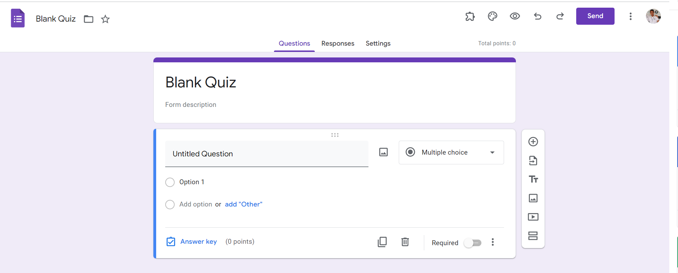
Identify root components of website below

Slide 2
Flex: 2
Navigation
Flex: 2
Header
Flex: 6
Main
Width: 100%;
Height: 100vh;
display: flex;
Flex-direction: column;
Justify-content: center;

Slide 3
Menu | Navigation
Item left
Item right
display: flex;
Width: 100%

Slide 4
Menu | Navigation (top)
Item left
Item right
logo
icon
icon
icon
icon
icon
icon
button
display: flex;
justify-content : flex-start:
Flex: 1;
display: flex;
justify-content : flex-end;
Flex: 1;

Slide 5
Menu | Navigation (bottom)
display: flex;
justify-content : center:
Align-items: center

Slide 6
Menu | Navigation (bottom)
button
button
button
Width: 70%
display: flex;
justify-content : center:
Align-items: center

Slide 7

Header
Text box
Input
display: flex;
Flex-direction: column;
Justify-content: space-evenly;
Width: 50%

Slide 8
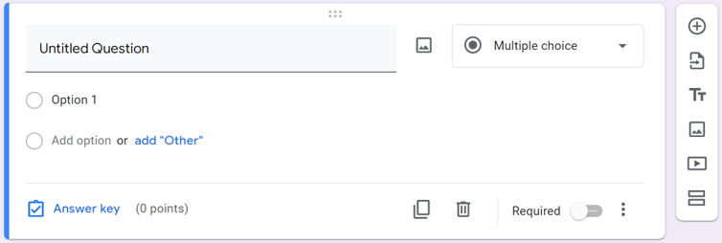
Main

Slide 9
Main
display: flex;
Width: 55%;
Gap: 10px;

Slide 10
Main
Flex: 1
Flex: 2
Flex: 1
display: flex;
Flex-direction: column;
Width: 10%
display: flex;
Flex-direction: column;
Width: 80%

Slide 11
Main
display: flex;
Justify-content: space-evenly;
Width: 100%;
Input
Label
icon
button
icon
Label
Input
icon
icon
display: flex;
Flex-direction: column;
Justify-content: space-evenly;
Width: 100%;
Label
icon
button
button
Label
icon
button
display: flex;
Flex-direction: column;
Justify-content: space-evenly;
Width: 10%;
display: flex;
Width: 100%;

